Slide 1
On Multiple Semantics for Declarative Database Repairs
Sudeepa Roy
Joint work with Amir Gilad* and Daniel Deutch
* Thanks for some slides!

Slide 2

Data Repair

Slide 3


Data Repair

Slide 4
Data Repair

Slide 5




Running Example
Pub
Cite
Writes
Authors
AuthGrant
Grant
Grant
AuthGrant
Author
Writes
Pub
 | fid | name
^{g}1 | 1 | NSF
^{g}2 | 2 | ERC
 | aid | fid
ag₁ | 2 | 1
ag₂ | 4 | 2
ag₃ | 5 | 2
 | aid | name
ª1 | 2 | Maggie
ª2 | 4 | Marge
ª3 | 5 | Homer
Cite
 | aid | pid
^{w}1 | 4 | 6
^{w}2 | 5 | 7
 | pid | title
^{p}1 | 6 | x
^{p}2 | 7 | y
 | citing | cited
c | 7 | 6
7 z
Tuple identifiers
Can we always stop there?

Slide 6
Outline
Constraints types
Delta rules
Four semantics
]
Algorithms
Experiments
Other / future work

Slide 7
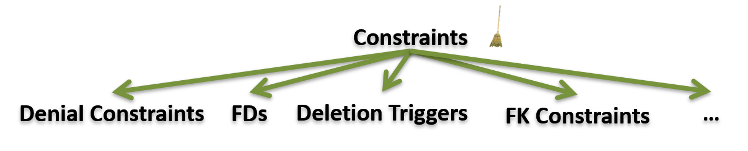
Constraints

Slide 8
Denial Constraints (DCs)
“There cannot be two different papers with the same title and a common author”
¬ (Pub(p1, t1) ∧ Pub(p2, t1) ∧ (p1 ≠ p2) ∧ Writes(a1, p1) ∧ Writes(a1, p2))
No dependency on previously deleted tuples
Any tuple can be removed
Grant
AuthGrant
Author
Writes
Pub
 | fid | name
^{g}1 | 1 | NSF
^{g}2 | 2 | ERC
 | aid | fid
ag₁ | 2 | 1
ag₂ | 4 | 2
ag₃ | 5 | 2
 | aid | name
ª1 | 2 | Maggie
ª2 | 4 | Marge
ª3 | 5 | Homer
Cite
 | aid | pid
^{w}1 | 4 | 6
^{w}2 | 5 | 7
 | pid | title
^{p}1 | 6 | x
^{p}2 | 7 | y
 | citing | cited
c | 7 | 6
5 8
8 y

Slide 9
Functional Dependencies (FDs)
“There cannot be two different papers with the same title”
Title determines pid : Title → pid
A special case of denial constraints
A special case of FDs : key constraints pid → Title
Optimal repair NP-hard for multiple FDs
Grant
AuthGrant
Author
Writes
Pub
 | fid | name
^{g}1 | 1 | NSF
^{g}2 | 2 | ERC
 | aid | fid
ag₁ | 2 | 1
ag₂ | 4 | 2
ag₃ | 5 | 2
 | aid | name
ª1 | 2 | Maggie
ª2 | 4 | Marge
ª3 | 5 | Homer
Cite
 | aid | pid
^{w}1 | 4 | 6
^{w}2 | 5 | 7
 | pid | title
^{p}1 | 6 | x
^{p}2 | 7 | y
 | citing | cited
c | 7 | 6
8 y
Kolahi-Lakhshmanan, ICDT’09
Livshits-Kimelfeld-Roy, PODS’18

Slide 10
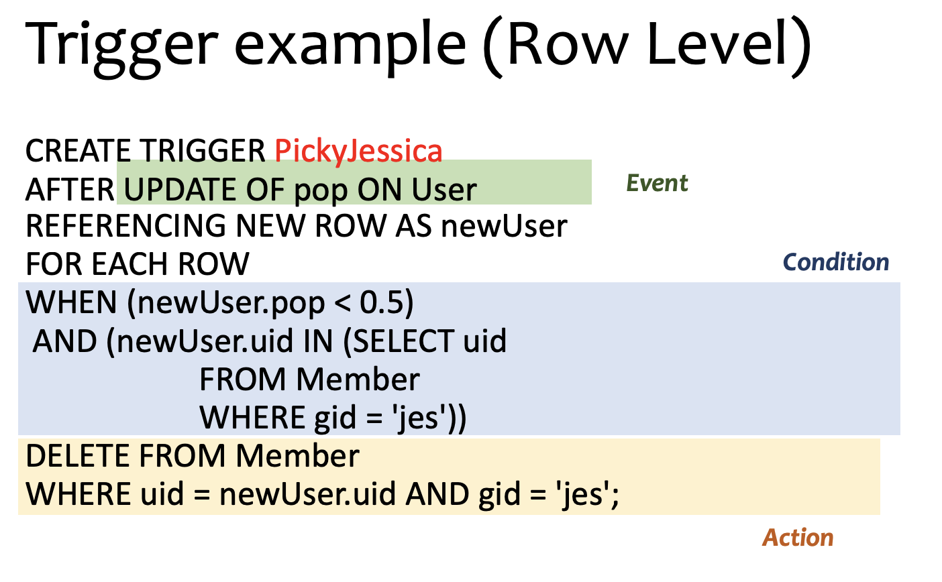
SQL Triggers
On deletion / insert / update ”events”, if a “condition” is satisfied (on each row or on the table), take some “actions”
Deletion depends on
previous deletions and some conditions
“If an author is deleted, remove her papers with no other coauthors”
Slide from undergrad DB course, schema to be ignored ☺
Grant
AuthGrant
Author
Writes
Pub
 | fid | name
^{g}1 | 1 | NSF
^{g}2 | 2 | ERC
 | aid | fid
ag₁ | 2 | 1
ag₂ | 4 | 2
ag₃ | 5 | 2
 | aid | name
ª1 | 2 | Maggie
ª2 | 4 | Marge
ª3 | 5 | Homer
Cite
 | aid | pid
^{w}1 | 4 | 6
^{w}2 | 5 | 7
 | pid | title
^{p}1 | 6 | x
^{p}2 | 7 | y
 | citing | cited
c | 7 | 6

Slide 11
Foreign keys / Referential integrity constraints
“Foreign key” (FK) refers to ”Primary key” (PK) of another table
Cascade delete semantics: if a tuple with PK is removed, then remove all tuples with its FKs
Deletion depends on previous deletions
Grant
AuthGrant
Author
Writes
Pub
 | fid | name
^{g}1 | 1 | NSF
^{g}2 | 2 | ERC
 | aid | fid
ag₁ | 2 | 1
ag₂ | 4 | 2
ag₃ | 5 | 2
 | aid | name
ª1 | 2 | Maggie
ª2 | 4 | Marge
ª3 | 5 | Homer
Cite
 | aid | pid
^{w}1 | 4 | 6
^{w}2 | 5 | 7
 | pid | title
^{p}1 | 6 | x
^{p}2 | 7 | y
 | citing | cited
c | 7 | 6

Slide 12
Motivation
Not always clear which kind is suitable to a given scenario Some forms do not follow consistent semantics for deletion

Slide 13
Motivation
Not always clear which kind is suitable to a given scenario Some forms do not follow consistent semantics for deletion
Consider a set of triggers involving multiple tables
MySQL: fire in the order they have been created
PostgreSQL: fire in alphabetical order
Can specify an order, but may not lead to min repair

Slide 14
This work: Delta Rules
A unified declarative model with multiple consistent semantics
Fits different use-cases / constraints
Allows for easy comparison between different interpretations of the constraints

Slide 15

Constraints Model - Delta Rules
Constraints
∆Grant(g, n) :- Grant(g, n), n = 'ERC '
∆Author(a, n ) :- Author(a, n), AuthGrant(a, g ), ∆Grant(g, gn)
∆Pub(p, t) :- Pub(p, t), Writes(a, p), ∆Author(a, n)
∆Writes(a, p) :-Pub(p, t), Writes(a, p), ∆Author(a, n)
∆_{cite} (c, p) :- Cite(c, p), ∆Pub(p, t), Writes(a1, c), Writes(a2, p)
Why ERC in US database?
Grant
AuthGrant
Author
Writes
Pub
 | fid | name
^{g}1 | 1 | NSF
^{g}2 | 2 | ERC
 | aid | fid
ag₁ | 2 | 1
ag₂ | 4 | 2
ag₃ | 5 | 2
 | aid | name
ª1 | 2 | Maggie
ª2 | 4 | Marge
ª3 | 5 | Homer
Cite
 | aid | pid
^{w}1 | 4 | 6
^{w}2 | 5 | 7
 | pid | title
^{p}1 | 6 | x
^{p}2 | 7 | y
 | citing | cited
c | 7 | 6

Slide 16
Constraints Model - Delta Rules
Constraints
∆Grant(g, n) :- Grant(g, n), n = 'ERC '
∆Author(a, n ) :- Author(a, n), AuthGrant(a, g ), ∆Grant(g, gn)
∆Pub(p, t) :- Pub(p, t), Writes(a, p), ∆Author(a, n)
∆Writes(a, p) :-Pub(p, t), Writes(a, p), ∆Author(a, n)
∆_{cite} (c, p) :- Cite(c, p), ∆Pub(p, t), Writes(a1, c), Writes(a2, p)
Why ERC in US database?
Grant
AuthGrant
Author
Writes
Pub
 | fid | name
^{g}1 | 1 | NSF
^{g}2 | 2 | ERC
 | aid | fid
ag₁ | 2 | 1
ag₂ | 4 | 2
ag₃ | 5 | 2
 | aid | name
ª1 | 2 | Maggie
ª2 | 4 | Marge
ª3 | 5 | Homer
Cite
 | aid | pid
^{w}1 | 4 | 6
^{w}2 | 5 | 7
 | pid | title
^{p}1 | 6 | x
^{p}2 | 7 | y
 | citing | cited
c | 7 | 6
Remove the ERC grant tuple

Slide 17
Constraints Model - Delta Rules
Constraints
∆Grant(g, n) :- Grant(g, n), n = 'ERC '
∆Author(a, n ) :- Author(a, n), AuthGrant(a, g ), ∆Grant(g, gn)
∆Pub(p, t) :- Pub(p, t), Writes(a, p), ∆Author(a, n)
∆Writes(a, p) :-Pub(p, t), Writes(a, p), ∆Author(a, n)
∆_{cite} (c, p) :- Cite(c, p), ∆Pub(p, t), Writes(a1, c), Writes(a2, p)
Why ERC in US database?
Grant
AuthGrant
Author
Writes
Pub
 | fid | name
^{g}1 | 1 | NSF
^{g}2 | 2 | ERC
 | aid | fid
ag₁ | 2 | 1
ag₂ | 4 | 2
ag₃ | 5 | 2
 | aid | name
ª1 | 2 | Maggie
ª2 | 4 | Marge
ª3 | 5 | Homer
Cite
 | aid | pid
^{w}1 | 4 | 6
^{w}2 | 5 | 7
 | pid | title
^{p}1 | 6 | x
^{p}2 | 7 | y
 | citing | cited
c | 7 | 6
If a Grant tuple is deleted and there is an author
who won a grant by this foundation (an AuthGrant tuple)
then delete the winning author

Slide 18
Constraints Model - Delta Rules
Constraints
∆Grant(g, n) :- Grant(g, n), n = 'ERC '
∆Author(a, n ) :- Author(a, n), AuthGrant(a, g ), ∆Grant(g, gn)
∆Pub(p, t) :- Pub(p, t), Writes(a, p), ∆Author(a, n)
∆Writes(a, p) :-Pub(p, t), Writes(a, p), ∆Author(a, n)
∆_{cite} (c, p) :- Cite(c, p), ∆Pub(p, t), Writes(a1, c), Writes(a2, p)
Why ERC in US database?
Grant
AuthGrant
Author
Writes
Pub
 | fid | name
^{g}1 | 1 | NSF
^{g}2 | 2 | ERC
 | aid | fid
ag₁ | 2 | 1
ag₂ | 4 | 2
ag₃ | 5 | 2
 | aid | name
ª1 | 2 | Maggie
ª2 | 4 | Marge
ª3 | 5 | Homer
Cite
 | aid | pid
^{w}1 | 4 | 6
^{w}2 | 5 | 7
 | pid | title
^{p}1 | 6 | x
^{p}2 | 7 | y
 | citing | cited
c | 7 | 6
Rest original and delta relations
Delta must belong to RHS

Slide 19
Constraints Model - Delta Rules
Constraints
∆Grant(g, n) :- Grant(g, n), n = 'ERC '
∆Author(a, n ) :- Author(a, n), AuthGrant(a, g ), ∆Grant(g, gn)
∆Pub(p, t) :- Pub(p, t), Writes(a, p), ∆Author(a, n)
∆Writes(a, p) :-Pub(p, t), Writes(a, p), ∆Author(a, n)
∆_{cite} (c, p) :- Cite(c, p), ∆Pub(p, t), Writes(a1, c), Writes(a2, p)
Why ERC in US database?
Grant
AuthGrant
Author
Writes
Pub
 | fid | name
^{g}1 | 1 | NSF
^{g}2 | 2 | ERC
 | aid | fid
ag₁ | 2 | 1
ag₂ | 4 | 2
ag₃ | 5 | 2
 | aid | name
ª1 | 2 | Maggie
ª2 | 4 | Marge
ª3 | 5 | Homer
Cite
 | aid | pid
^{w}1 | 4 | 6
^{w}2 | 5 | 7
 | pid | title
^{p}1 | 6 | x
^{p}2 | 7 | y
 | citing | cited
c | 7 | 6
* Rules chosen for illustration purposes

Slide 20
Constraints Model - Delta Rules
Delta relations are auxiliary relations that keep track of deleted tuples The database is clean when no delta rule can be satisfied
Constraints
∆Grant(g, n) :- Grant(g, n), n = 'ERC '
∆Author(a, n ) :- Author(a, n), AuthGrant(a, g ), ∆Grant(g, gn)
∆Pub(p, t) :- Pub(p, t), Writes(a, p), ∆Author(a, n)
∆Writes(a, p) :-Pub(p, t), Writes(a, p), ∆Author(a, n)
∆_{cite} (c, p) :- Cite(c, p), ∆Pub(p, t), Writes(a1, c), Writes(a2, p)
Grant
AuthGrant
Author
Writes
Pub
 | fid | name
^{g}1 | 1 | NSF
^{g}2 | 2 | ERC
 | aid | fid
ag₁ | 2 | 1
ag₂ | 4 | 2
ag₃ | 5 | 2
 | aid | name
ª1 | 2 | Maggie
ª2 | 4 | Marge
ª3 | 5 | Homer
Cite
 | aid | pid
^{w}1 | 4 | 6
^{w}2 | 5 | 7
 | pid | title
^{p}1 | 6 | x
^{p}2 | 7 | y
 | citing | cited
c | 7 | 6
∆Grant
∆AuthGrant
∆Author
∆Cite
∆Writes
∆Pub
fid name
aid fid
aid name
citing cited
aid pid
pid title

Slide 21
Stabilizing set: No rules can be fired
Move tuples
in stabilizing set to
Delta relations
Grant
AuthGrant
Author
Writes
Pub
 | fid | name
^{g}1 | 1 | NSF
^{g}2 | 2 | ERC
 | aid | fid
ag₁ | 2 | 1
ag₂ | 4 | 2
ag₃ | 5 | 2
 | aid | name
ª1 | 2 | Maggie
ª2 | 4 | Marge
ª3 | 5 | Homer
Cite
 | aid | pid
^{w}1 | 4 | 6
^{w}2 | 5 | 7
 | pid | title
^{p}1 | 6 | x
^{p}2 | 7 | y
 | citing | cited
c | 7 | 6
AuthGrant
Author
Cite
Writes
Pub
 | aid | fid
ag₁ | 2 | 1
 | aid | name
ª1 | 2 | Maggie
citing cited
aid pid
pid title
∆Author
∆
Cite
∆Writes
∆Pub
∆AuthGrant
 | aid | name
ª2 | 4 | Marge
ª3 | 5 | Homer
 | citing | cited
c | 7 | 6
 | aid | pid
^{w}1 | 4 | 6
^{w}2 | 5 | 7
 | pid | title
^{p}1 | 6 | x
^{p}2 | 7 | y
 | aid | fid
ag₂ | 4 | 2
ag₃ | 5 | 2
{ag2, ag3}
{a2, a3, p1, p2, w1, w2, c}
{a2, a3, w1, w2}
{a2, a3, p1, p2, w1, w2}
{a2, a3, w1, p2}
Do not
belong to
a rule head
Tuples belong to rule head and “generated” by rules
How do we find these sets?

Slide 22
Four semantics of repair with delta rules
Constraints
∆Grant(g, n) :- Grant(g, n), n = 'ERC '
∆Author(a, n ) :- Author(a, n), AuthGrant(a, g ), ∆Grant(g, gn)
∆Pub(p, t) :- Pub(p, t), Writes(a, p), ∆Author(a, n)
∆Writes(a, p) :-Pub(p, t), Writes(a, p), ∆Author(a, n)
∆_{cite} (c, p) :- Cite(c, p), ∆Pub(p, t), Writes(a1, c), Writes(a2, p)
Why ERC in US database?
Grant
AuthGrant
Author
Writes
Pub
 | fid | name
^{g}1 | 1 | NSF
^{g}2 | 2 | ERC
 | aid | fid
ag₁ | 2 | 1
ag₂ | 4 | 2
ag₃ | 5 | 2
 | aid | name
ª1 | 2 | Maggie
ª2 | 4 | Marge
ª3 | 5 | Homer
Cite
 | aid | pid
^{w}1 | 4 | 6
^{w}2 | 5 | 7
 | pid | title
^{p}1 | 6 | x
^{p}2 | 7 | y
 | citing | cited
c | 7 | 6
Independent semantics
End semantics
Stage semantics
Step semantics

Slide 23
Independent Semantics
Independent semantics (DCs / FDs): Any tuple involved in an assignment can be deleted (Globally Optimal Stabilizing Set/ “Min Repair”)
Constraints
∆Grant(g, n) :- Grant(g, n), n = 'ERC '
∆Author(a, n ) :- Author(a, n), AuthGrant(a, g ), ∆Grant(g, gn)
∆Pub(p, t) :- Pub(p, t), Writes(a, p), ∆Author(a, n)
∆Writes(a, p) :-Pub(p, t), Writes(a, p), ∆Author(a, n)
∆_{cite} (c, p) :- Cite(c, p), ∆Pub(p, t), Writes(a1, c), Writes(a2, p)
Author
Writes
Pub
Grant
AuthGrant
 | aid | name
ª1 | 2 | Maggie
ª2 | 4 | Marge
ª3 | 5 | Homer
Cite
 | aid | pid
^{w}1 | 4 | 6
^{w}2 | 5 | 7
 | pid | title
^{p}1 | 6 | x
^{p}2 | 7 | y
 | fid | name
^{g}1 | 1 | NSF
 | aid | fid
ag₁ | 2 | 1
 | citing | cited
c | 7 | 6
∆Grant
∆AuthGrant
 | fid | name
^{g}2 | 2 | ERC
 | aid | fid
ag₂ | 4 | 2
ag₃ | 5 | 2
∆Author
∆Cite
∆Writes
∆Pub
aid name
citing cited
aid pid
pid title

Slide 24
End Semantics
End semantics (deletion triggers/FK-constraints): Similar to "datalog" evaluation. Derive all delta tuples and delete the regular only at the end of the evaluation process (when no more rules can be fired)
Constraints
∆Grant(g, n) :- Grant(g, n), n = 'ERC '
∆Author(a, n ) :- Author(a, n), AuthGrant(a, g ), ∆Grant(g, gn)
∆Pub(p, t) :- Pub(p, t), Writes(a, p), ∆Author(a, n)
∆Writes(a, p) :-Pub(p, t), Writes(a, p), ∆Author(a, n)
∆_{cite} (c, p) :- Cite(c, p), ∆Pub(p, t), Writes(a1, c), Writes(a2, p)
Grant
AuthGrant
Author
Writes
Pub
 | fid | name
^{g}1 | 1 | NSF
^{g}2 | 2 | ERC
 | aid | fid
ag₁ | 2 | 1
ag₂ | 4 | 2
ag₃ | 5 | 2
 | aid | name
ª1 | 2 | Maggie
ª2 | 4 | Marge
ª3 | 5 | Homer
Cite
 | aid | pid
^{w}1 | 4 | 6
^{w}2 | 5 | 7
 | pid | title
^{p}1 | 6 | x
^{p}2 | 7 | y
 | citing | cited
c | 7 | 6
AuthGrant
Grant
 | aid | fid
ag₁ | 2 | 1
ag₂ | 4 | 2
ag₃ | 5 | 2
Author
Cite
Writes
Pub
 | fid | name
^{g}1 | 1 | NSF
 | aid | name
ª1 | 2 | Maggie
citing cited
aid pid
pid title
∆
Grant
∆Author
∆
Cite
∆Writes
∆Pub
 | fid | name
^{g}2 | 2 | ERC
∆AuthGrant
 | aid | name
ª2 | 4 | Marge
ª3 | 5 | Homer
 | citing | cited
c | 7 | 6
 | aid | pid
^{w}1 | 4 | 6
^{w}2 | 5 | 7
 | pid | title
^{p}1 | 6 | x
^{p}2 | 7 | y
aid fid
Now remove tuples

Slide 25
Stage Semantics
Stage semantics (deletion triggers/FK-constraints): Derive delta tuples and delete the tuples in stages (like semi-naïve datalog evaluation)
Constraints
∆Grant(g, n) :- Grant(g, n), n = 'ERC '
∆Author(a, n ) :- Author(a, n), AuthGrant(a, g ), ∆Grant(g, gn)
∆Pub(p, t) :- Pub(p, t), Writes(a, p), ∆Author(a, n)
∆Writes(a, p) :-Pub(p, t), Writes(a, p), ∆Author(a, n)
∆_{cite} (c, p) :- Cite(c, p), ∆Pub(p, t), Writes(a1, c), Writes(a2, p)
No other rules
fire - remove
Rule 5 does
not fire
Grant
AuthGrant
Author
Writes
Pub
 | fid | name
^{g}1 | 1 | NSF
^{g}2 | 2 | ERC
 | aid | fid
ag₁ | 2 | 1
ag₂ | 4 | 2
ag₃ | 5 | 2
 | aid | name
ª1 | 2 | Maggie
ª2 | 4 | Marge
ª3 | 5 | Homer
Cite
 | aid | pid
^{w}1 | 4 | 6
^{w}2 | 5 | 7
 | pid | title
^{p}1 | 6 | x
^{p}2 | 7 | y
 | citing | cited
c | 7 | 6
Grant
 | aid | fid
ag₁ | 2 | 1
ag₂ | 4 | 2
ag₃ | 5 | 2
Author
Cite
Writes
Pub
 | fid | name
^{g}1 | 1 | NSF
 | aid | name
ª1 | 2 | Maggie
 | citing | cited
c | 7 | 6
aid pid
pid title
∆
Grant
∆Author
∆Writes
∆Pub
 | fid | name
^{g}2 | 2 | ERC
∆AuthGrant
 | aid | name
ª2 | 4 | Marge
ª3 | 5 | Homer
∆Cite
 | aid | pid
^{w}1 | 4 | 6
^{w}2 | 5 | 7
 | pid | title
^{p}1 | 6 | x
^{p}2 | 7 | y
aid fid
citing cited

Slide 26
Step Semantics
Step semantics (deletion triggers/FK-constraints): Delete a tuple
non-deterministically immediately after deriving its delta counterpart
Constraints
∆Grant(g, n) :- Grant(g, n), n = 'ERC '
∆Author(a, n ) :- Author(a, n), AuthGrant(a, g ), ∆Grant(g, gn)
∆Pub(p, t) :- Pub(p, t), Writes(a, p), ∆Author(a, n)
∆Writes(a, p) :-Pub(p, t), Writes(a, p), ∆Author(a, n)
∆_{cite} (c, p) :- Cite(c, p), ∆Pub(p, t), Writes(a1, c), Writes(a2, p)
Rule 3, 5 do
not fire
Other results
are possible
Grant
AuthGrant
Author
Writes
Pub
 | fid | name
^{g}1 | 1 | NSF
^{g}2 | 2 | ERC
 | aid | fid
ag₁ | 2 | 1
ag₂ | 4 | 2
ag₃ | 5 | 2
 | aid | name
ª1 | 2 | Maggie
ª2 | 4 | Marge
ª3 | 5 | Homer
Cite
 | aid | pid
^{w}1 | 4 | 6
^{w}2 | 5 | 7
 | pid | title
^{p}1 | 6 | x
^{p}2 | 7 | y
 | citing | cited
c | 7 | 6
AuthGrant
Pub
Grant
 | aid | fid
ag₁ | 2 | 1
ag₂ | 4 | 2
ag₃ | 5 | 2
Author
Cite
Writes
 | pid | title
^{p}1 | 6 | x
^{p}2 | 7 | y
 | fid | name
^{g}1 | 1 | NSF
 | aid | name
ª1 | 2 | Maggie
 | citing | cited
c | 7 | 6
aid pid
∆
Grant
∆Author
∆Writes
 | fid | name
^{g}2 | 2 | ERC
∆AuthGrant
 | aid | name
ª2 | 4 | Marge
ª3 | 5 | Homer
∆Cite
 | aid | pid
^{w}1 | 4 | 6
^{w}2 | 5 | 7
∆Pub
aid fid
citing cited
pid title

Slide 27
Stage vs. Step Semantics Semantics
Step semantics: non-deterministic, result depends on the order of rules fired
Stage semantics: deterministic, each stage depends on all delta relations of previous step. Rules are monotone ⇒ Unique fixpoint in poly-time
Constraints
∆Grant(g, n) :- Grant(g, n), n = 'ERC '
∆Author(a, n ) :- Author(a, n), AuthGrant(a, g ), ∆Grant(g, gn)
∆Pub(p, t) :- Pub(p, t), Writes(a, p), ∆Author(a, n)
∆Writes(a, p) :-Pub(p, t), Writes(a, p), ∆Author(a, n)
∆_{cite} (c, p) :- Cite(c, p), ∆Pub(p, t), Writes(a1, c), Writes(a2, p)
Grant
AuthGrant
Author
Writes
Pub
 | fid | name
^{g}1 | 1 | NSF
^{g}2 | 2 | ERC
 | aid | fid
ag₁ | 2 | 1
ag₂ | 4 | 2
ag₃ | 5 | 2
 | aid | name
ª1 | 2 | Maggie
ª2 | 4 | Marge
ª3 | 5 | Homer
Cite
 | aid | pid
^{w}1 | 4 | 6
^{w}2 | 5 | 7
 | pid | title
^{p}1 | 6 | x
^{p}2 | 7 | y
 | citing | cited
c | 7 | 6
Grant
 | aid | fid
ag₁ | 2 | 1
ag₂ | 4 | 2
ag₃ | 5 | 2
Author
Cite
Writes
Pub
 | fid | name
^{g}1 | 1 | NSF
 | aid | name
ª1 | 2 | Maggie
 | citing | cited
c | 7 | 6
aid pid
pid title
∆
Grant
∆Author
∆Writes
∆Pub
 | fid | name
^{g}2 | 2 | ERC
∆AuthGrant
 | aid | name
ª2 | 4 | Marge
ª3 | 5 | Homer
∆Cite
 | aid | pid
^{w}1 | 4 | 6
^{w}2 | 5 | 7
 | pid | title
^{p}1 | 6 | x
^{p}2 | 7 | y
aid fid
citing cited

Slide 28
Semantics Summary
Four Semantics for the Delta Rules
Semantics | Delete only specified tuples? | When deletion occurs | Use/Similar to
Independent |  | Not Operational | DC, FD
End | ✓ | At the end of evaluation | Deletion triggers FK-constraints
Stage | ✓ | In stages | Deletion triggers FK-constraints
Step | ✓ | After a constraint is used | Deletion triggers FK-constraints

Slide 29
End and Stage semantics are poly-time (data complexity)
Rules are monotone, order does not matter
Polynomially many delta tuples possible
⇒ Unique fixpoint in poly-time
Constraints
∆Grant(g, n) :- Grant(g, n), n = 'ERC '
∆Author(a, n ) :- Author(a, n), AuthGrant(a, g ), ∆Grant(g, gn)
∆Pub(p, t) :- Pub(p, t), Writes(a, p), ∆Author(a, n)
∆Writes(a, p) :-Pub(p, t), Writes(a, p), ∆Author(a, n)
∆_{cite} (c, p) :- Cite(c, p), ∆Pub(p, t), Writes(a1, c), Writes(a2, p)
Grant
AuthGrant
Author
Writes
Pub
 | fid | name
^{g}1 | 1 | NSF
^{g}2 | 2 | ERC
 | aid | fid
ag₁ | 2 | 1
ag₂ | 4 | 2
ag₃ | 5 | 2
 | aid | name
ª1 | 2 | Maggie
ª2 | 4 | Marge
ª3 | 5 | Homer
Cite
 | aid | pid
^{w}1 | 4 | 6
^{w}2 | 5 | 7
 | pid | title
^{p}1 | 6 | x
^{p}2 | 7 | y
 | citing | cited
c | 7 | 6
Grant
 | aid | fid
ag₁ | 2 | 1
ag₂ | 4 | 2
ag₃ | 5 | 2
Author
Cite
Writes
Pub
 | fid | name
^{g}1 | 1 | NSF
 | aid | name
ª1 | 2 | Maggie
 | citing | cited
c | 7 | 6
aid pid
pid title
∆
Grant
∆Author
∆Writes
∆Pub
 | fid | name
^{g}2 | 2 | ERC
∆AuthGrant
 | aid | name
ª2 | 4 | Marge
ª3 | 5 | Homer
∆Cite
 | aid | pid
^{w}1 | 4 | 6
^{w}2 | 5 | 7
 | pid | title
^{p}1 | 6 | x
^{p}2 | 7 | y
aid fid
citing cited

Slide 30

Results
Theoretical results in a figure
End (PTime)
Run Datalog
⊆
⊇
Stage (PTime)
Step (NP-hard)
≥
≤
Independent (NP-hard)
Full version with the propositions and proofs:

Slide 31
NP hardness: Step Semantics
Step semantics: Simple reduction from vertex cover
Constraint
∆VC(x) :- E(x, y), VC(x), VC(y)
Add vertices in vertex cover to ∆VC
For Independent semantics,
more rules needed to stop E tuples to be deleted

Slide 32
Algorithm for Independent Semantics
Constraints
∆Grant(g, n) :- Grant(g, n), n = 'ERC '
∆Author(a, n ) :- Author(a, n), AuthGrant(a, g ), ∆Grant(g, gn)
∆Pub(p, t) :- Pub(p, t), Writes(a, p), ∆Author(a, n)
∆Writes(a, p) :-Pub(p, t), Writes(a, p), ∆Author(a, n)
∆_{cite} (c, p) :- Cite(c, p), ∆Pub(p, t), Writes(a1, c), Writes(a2, p)
Grant
AuthGrant
Author
Writes
Pub
 | fid | name
^{g}1 | 1 | NSF
^{g}2 | 2 | ERC
 | aid | fid
ag₁ | 2 | 1
ag₂ | 4 | 2
ag₃ | 5 | 2
 | aid | name
ª1 | 2 | Maggie
ª2 | 4 | Marge
ª3 | 5 | Homer
Cite
 | aid | pid
^{w}1 | 4 | 6
^{w}2 | 5 | 7
 | pid | title
^{p}1 | 6 | x
^{p}2 | 7 | y
 | citing | cited
c | 7 | 6
All possible assignments
Run a SAT solver
Minimum Falses for satisfying assignment
¬g₂ ∧ (¬a₂ ∨ ¬ag₂ ∨ g₂) ∧ (¬a₃ ∨ ¬ag₃ ∨ g₂) ∧ (¬p₁ ∨ ¬w₁ ∨ a₂)∧
(¬p₂ ∨ ¬w₂ ∨ a₃) ∧ (¬c ∨ p₁ ∨ ¬w₁ ∨ ¬w₂)
¬(a2 ∧ ag2 ∧ ¬g2)

Slide 33
Algorithm (heuristic) for Step Semantics
Constraints
∆Grant(g, n) :- Grant(g, n), n = 'ERC '
∆Author(a, n ) :- Author(a, n), AuthGrant(a, g ), ∆Grant(g, gn)
∆Pub(p, t) :- Pub(p, t), Writes(a, p), ∆Author(a, n)
∆Writes(a, p) :-Pub(p, t), Writes(a, p), ∆Author(a, n)
∆_{cite} (c, p) :- Cite(c, p), ∆Pub(p, t), Writes(a1, c), Writes(a2, p)
Grant
AuthGrant
Author
Writes
Pub
 | fid | name
^{g}1 | 1 | NSF
^{g}2 | 2 | ERC
 | aid | fid
ag₁ | 2 | 1
ag₂ | 4 | 2
ag₃ | 5 | 2
 | aid | name
ª1 | 2 | Maggie
ª2 | 4 | Marge
ª3 | 5 | Homer
Cite
 | aid | pid
^{w}1 | 4 | 6
^{w}2 | 5 | 7
 | pid | title
^{p}1 | 6 | x
^{p}2 | 7 | y
 | citing | cited
c | 7 | 6
Provenance Graph
∆(c)
∆(w1) ∆(p1)
∆(p2) ∆(w2)
∆(a2)
∆(a3)
∆(g2)
w₁, 3 p1, 1 a₂, −1 ag₂, ∅ g2, −1 ag₃, ∅ a₃, −1 p2, 2 w₂, 3 c, 1

Slide 34
Algorithm (heuristic) for Step Semantics
Constraints
∆Grant(g, n) :- Grant(g, n), n = 'ERC '
∆Author(a, n ) :- Author(a, n), AuthGrant(a, g ), ∆Grant(g, gn)
∆Pub(p, t) :- Pub(p, t), Writes(a, p), ∆Author(a, n)
∆Writes(a, p) :-Pub(p, t), Writes(a, p), ∆Author(a, n)
∆_{cite} (c, p) :- Cite(c, p), ∆Pub(p, t), Writes(a1, c), Writes(a2, p)
Grant
AuthGrant
Author
Writes
Pub
 | fid | name
^{g}1 | 1 | NSF
^{g}2 | 2 | ERC
 | aid | fid
ag₁ | 2 | 1
ag₂ | 4 | 2
ag₃ | 5 | 2
 | aid | name
ª1 | 2 | Maggie
ª2 | 4 | Marge
ª3 | 5 | Homer
Cite
 | aid | pid
^{w}1 | 4 | 6
^{w}2 | 5 | 7
 | pid | title
^{p}1 | 6 | x
^{p}2 | 7 | y
 | citing | cited
c | 7 | 6
Greedily choosing the smallest number of tuples at each level
∆(c)
∆(w1) ∆(p1)
∆(p2) ∆(w2)
∆(a2)
∆(a3)
∆(g2)
w₁, 3 p1, 1 a₂, −1 ag₂, ∅ g2, −1 ag₃, ∅ a₃, −1 p2, 2 w₂, 3 c, 1
Poly-time in data complexity

Slide 35
Experimental Setup
Datasets: Microsoft Academic Search (MAS) and TPC-H Programs: 20 MAS programs and 6 TPC-H programs
Metrics examined for all semantics: containment of results for the different semantics, size of the results, runtime, runtime breakdown for independent and step semantics
Comparison with MySQL and PostgreSQL triggers, and HoloClean¹
Example MAS Programs
Num. | Program
11–15 | 11 12 13 ∆_{C} (pid, c₂ ) : −{{{{{C (pid, c₂ )} , P(t, pid )} , W (aid, pid )} , 14 15 A(aid, n, oid )} , O(oid, n₂ )}
16–20 | (1) ∆_{O} (oid, n₂ ) : −O(oid, n₂ ), oid = C (prog. 16-20) ∆_{A} (aid, n, oid ) : −A(aid, n, oid ), ∆_{O} (oid, n₂ ) (prog. 17-20) ∆_{W} (aid, pid ) : −W (aid, pid ), ∆_{A} (aid, n, oid ) (prog. 18-20) (4) ∆_{P} (pid, t) : −P(pid, t), ∆_{W} (aid, pid ) (prog. 19-20) (5) ∆_{C} (citing, pid ) : −C (citing, pid ), ∆_{P} (pid, t) (prog. 20)
¹Theodoros Rekatsinas et al. “HoloClean: Holistic Data Repairs with Probabilistic Inference”. In: PVLDB 10.11 (2017), pp. 1190–1201.

Slide 36
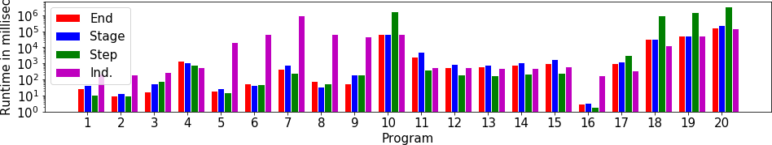
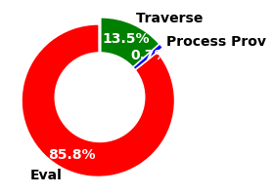
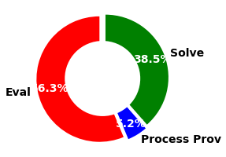
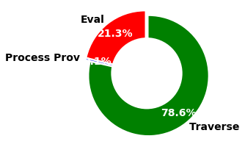
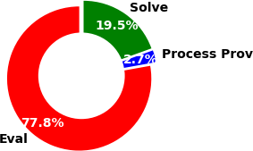
Runtime Experiments for MAS
The algorithms for independent and step semantics dominate.
It is very time consuming for independent semantics to find a minimum satisfying assignment and for step to traverse the provenance graph.
(a) Ind. (1–15)
(b) Step (1–15)
(c) Ind. (16–20)
(d) Step (16–20)

Slide 37
Comparison to HoloClean
HoloClean relaxes the constraints and uses machine learning to infer the most likely value changes
Our semantics guarantee that all constraints will be satisfied using
tuple deletions
One of the performed comparisons to HoloClean with 4 denial constraints and a table with 5000 tuples
Number of over deletions (+) for each of the four semantics compared with number of under repaired tuples (−) by HoloClean for an increasing the number of errors
 | Deleted Tuples |  |  |  | Repaired Tuples
Errors | Ind | Step | Stage | End | HoloClean
100 | +0 | +0 | +389 | +389 | -26
200 | +0 | +1 | +479 | +479 | -60
300 | +0 | +5 | +630 | +630 | -128
500 | +0 | +16 | +786 | +786 | -234
700 | +0 | +21 | +878 | +878 | -480
1000 | +0 | +34 | +1000 | +1000 | -693

Slide 38
Related Work
Data Repair
Various constraints forms including functional dependencies and versions thereof [Bohannon et al., 07’], [Koudas et al., 09’], denial constraints [Chomicki et al., 05’], and SQL triggers
Repairing through tuple deletions [Chomicki et al., 05’], [Lopatenko et al., 07’] or through cell value repair [Rekatsinas et al., 17’], [Chu et al., 13’], [Livshits et al., 18’], [Kolahi et al., 09’]
Declarative data repair [Rekatsinas et al., 17’], [Fagin et al., 16’]
Related Fields
Causality in databases [Meliou et al., 10’], [Roy et al., 14’, 15’] Deletion propagation [Buneman et al., 02’], [Cong et al., 06’]

Slide 39
Our other work on data repair
Inconsistency measures [Livshits et al. SIGMOD’21]
  Properties and complexity
Complexity for data repair under FDs [Livshits et al. PODS’18]
Aggregated deletion propagation [Hu et al. PVLDB’20]
  Min number of tuples to delete say 50 output tuples
  Complexity and dichotomy

Slide 40
Summary
Main Contributions
Formulate a single framework for four consistent deletion semantics
Characterization of the complexity and relationships between the semantics
Devising provenance-based algorithms for independent and step semantics
Future Work
Extend the algorithms to support recursion Generalize the framework for tuple insertions and updates

Slide 41


Thank You
Questions?

